Slide 1
Class Basics
CS 201, Summer 2013

Slide 2
ADDITIONAL READING
Classes
  Chapter 6 of Pearson book
  http://www.cplusplus.com/doc/tutorial/classes/
  http://www.learncpp.com/cpp-tutorial/81-welcome-to-object-oriented-programming/

Slide 3
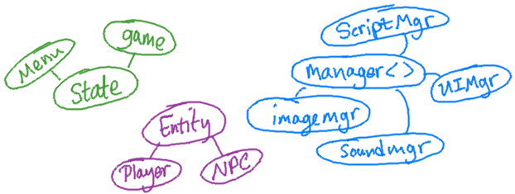
Object Oriented Programming (“OOP”)
Object Oriented Programming is a programming paradigm, a way of designing your software to (hopefully) keep it modular and easy to maintain and add on to.

Slide 4
Applications?
Online retail
In-store P.O.S.
Business management
Simulation
  Traffic, War, etc.
Accessibility tools
  Text to speech
So many applications...
Have a problem? How can we apply software to it?
What is an area that software couldn't help at all?

Slide 5
OOP is a Paradigm
Other programming paradigms include:
  Declaritive
  Functional
  Imperative
  Object Oriented
As with anything else, there is debate on the best paradigm, language, etc.

Slide 6
What are objects?
Storing variables and functions within a structure or class.
Create your own data-type, can declare variables with this object.
Similar to functions, you must declare (and define) the internals before using them.
Class declarations are usually stored in header (.h) files, and the definitions of a class' functions are stored in a source (.cpp) file.

Slide 7
Structs vs. Classes
C++ lets you create Structs and Classes.
  Structs are available in C, but classes are not.
Usually, structs should be used for simpler objects – encapsulating simple data.
  A “vector” struct that stores an x and y variable.
  An “error” struct, with a “error message” and an “error code” number.

Slide 8


Structs vs. Classes

Slide 9
Structs vs. Classes
Classes should be used for more complex objects, with variables and functions.
Structs and Classes can both hold variables and functions.
  Struct members are public by default
  Class members are private by default
A “Member” is a variable or a function that belongs to the class/struct.

Slide 10
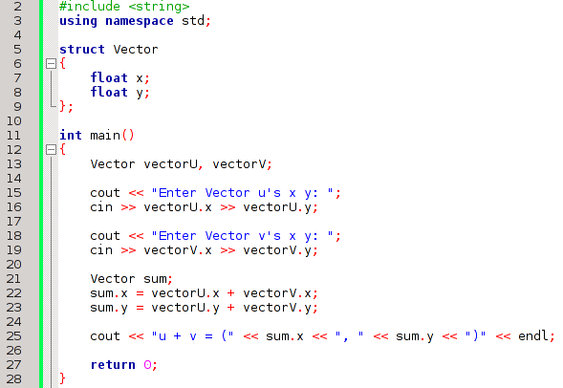
Using structs
Declaring a struct
Structs & classes must end with a semicolon!
Creating two instances of the Vector struct
Access members of the struct with a period, then the member name.

Slide 11


The Semicolon
If you forget the semicolon at the end of your struct or class, you'll get a compile error.

Slide 12
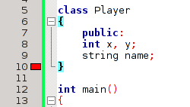
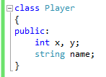


The Semicolon
If you forget the semicolon at the end of your struct or class, you'll get a compile error.
Visual Studio 2012
Code::Blocks

Slide 13
Creating a Class
In C++, you will create a class in a separate file than your main.cpp (or whatever you name it) source file.
  A class will get two files – [classname].h and [classname].cpp
    You might also see “.hpp” rather than “.h”. .h is a holdover from C, but still commonly used for naming.
  The header (.h) file holds the Class Declaration, and the source file (.cpp) holds the Class Definition

Slide 14
Creating a Class
Remember:
  A function Declaration is simply the header itself
    Return type
    Function name
    Parameter list
  A function Definition includes the header and the body of code – the actual functionality.

Slide 15
Creating a Class
With classes, the declaration will specify the class name and the name of its member variables, and the declarations of its member functions.
The class definition will mainly consist of its member function definitions.

Slide 16
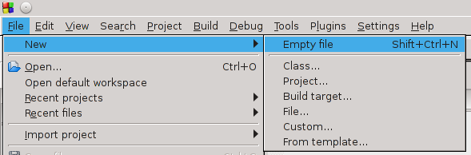
Creating a Class
Code::Blocks
In Code::Blocks, go to File, New, and then Empty File

Slide 17
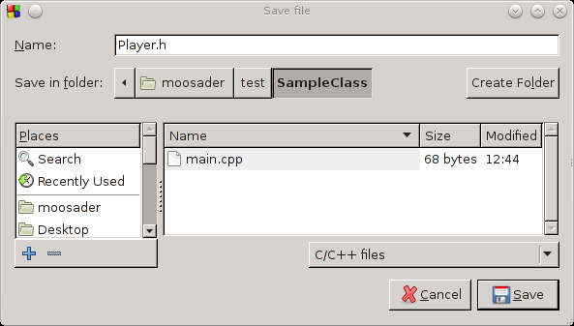
Creating a Class
Code::Blocks
Create two files, [classname].h and [classname].cpp

Slide 18

Preprocessor #ifndef
In the header file, we must add a preprocessor statement:
#ifndef _CLASSNAME
preprocessor “if not defined” statement
#define _CLASSNAME
preprocessor “define” statement
#endif
preprocessor “end if”

Slide 19
Preprocessor #ifndef
A preprocessor statement is:
  Commands for the compiler to follow, not the program itself.
  Begin with pound signs #
  Is a single line of code

Slide 20
Preprocessor #ifndef
In C++, when you #include a file, during compile-time the compiler takes the contents of that file and copies them into the main source file.
  Essentially, it creates one big source file with everything you use.

Slide 21
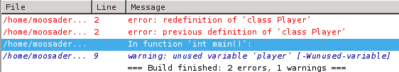
Preprocessor #ifndef
If you have multiple .h files in your program, and you need to #include a specific .h file in multiple other files, the compiler is going to copy that .h file into your program multiple times and you'll get this error:
  Redefinition of that class

Slide 22
Preprocessor #ifndef
The #ifndef, #define, and #endif statements tell the Compiler:
  If this “_PLAYER” flag has not been defined yet...
  Define a “_PLAYER” flag.
  Do this internal stuff
  End of the if statement

Slide 23
Preprocessor #ifndef
With this statement, now the compiler will see that _PLAYER has been defined once before, and not copy it multiple times when it is building the big source file.

Slide 24
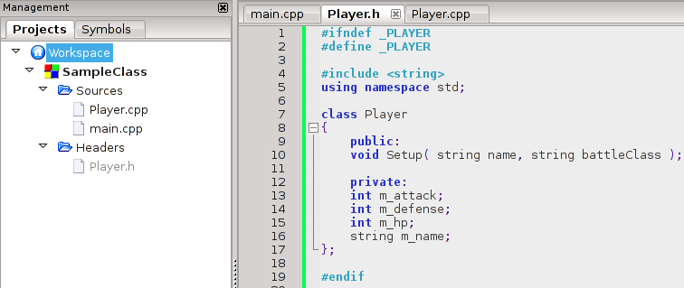
Preprocessor #ifndef
Any normal source code goes between the #define and the #endif statement

Slide 25
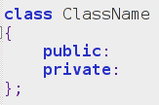
Class declaration
When we declare our class, it will be in the form of:
class keyword
Public members (interface for user)
Member variables & functions (inner-workings)
Don't forget semicolon!

Slide 26
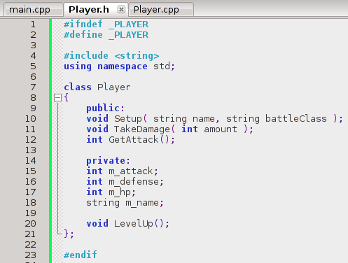
Class declaration
Declare public member functions
Declare private member variables
Can declare private functions

Slide 27
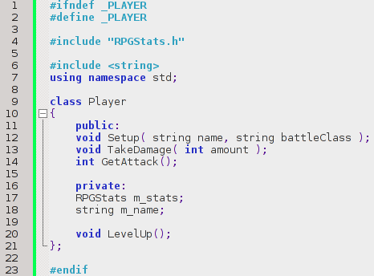
Class declaration
A class can also have other classes or structs as members.
Helps keeps things that are logically separate – separate!
Makes possibly common attributes reusable between many classes.

Slide 28

Class definition
In the corresponding .cpp file, we will define our functions.
First, we need to include the .h file for the class.
Notice how, for files we create, you will use “” for the #include. But with third-party libraries, we will use <>.
No #ifndef statement needed – that is only for class declarations (.h files)

Slide 29
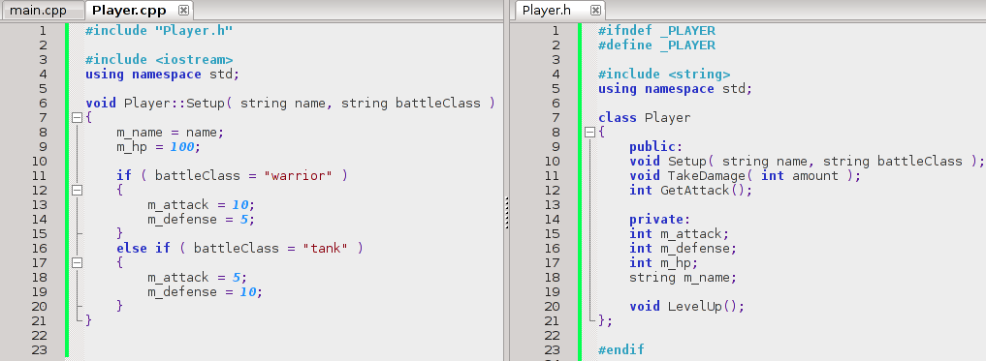
Class definition
We can then write our class' function definitions in the .cpp file.
Notice that for the Setup function, we must have Player:: as a prefix. This is the “Scope Resolution Operator”.
In Visual Studio and Code::Blocks, you can click-and-drag a file tab to the side of the screen to get a split-screen view!

Slide 30
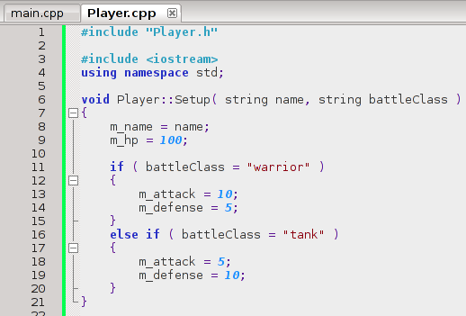
Class definition
The Scope Resolution Operator is:
  The class name and two colons before the function name.
  It specifies that the function belongs to the class
    Multiple classes might have a “Setup” function!

Slide 31
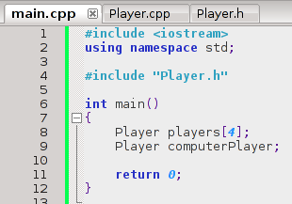
Creating an instance
When you create an instance of a class, you're essentially declaring a variable with that class as the data type. You can do this as many times as you want:
Anything using the class must #include it.
You can even create an array of this class!

Slide 32
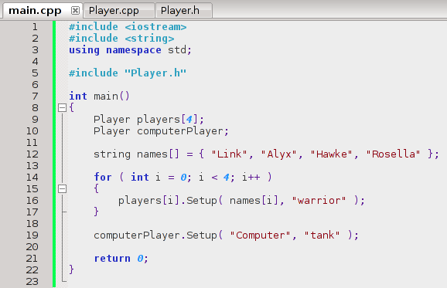
Creating an instance
To access a public function (or variable) of a class, you use the dot operator “.”

Slide 33
Object Oriented Programming
Creating classes is also just as simple, but also more in-depth.
Classes are part of the foundation of OOP (Object Oriented Programming)
With OOP, we put a lot of thought into the design of our program's code, for several reasons.

Slide 34
Object Oriented Programming (Design)
When we create objects (via classes) in C++, we are concerned with creating an interface.
An Interface is what the user sees of the class (user being another developer, usually).
If you use premade libraries from someone else, usually you know what functions you can call, but you don't get to see the inner-workings (or don't care).

Slide 35
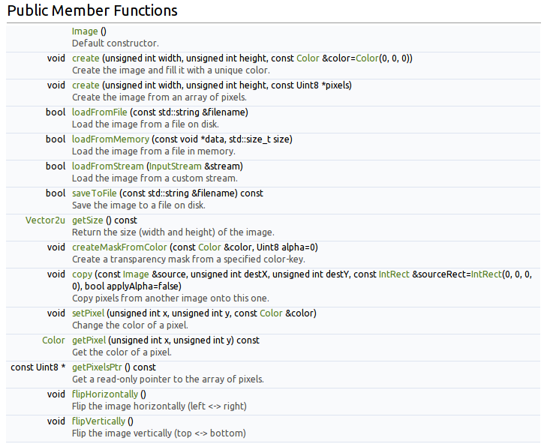
Object Oriented Programming (Design)
This is documentation from the SFML 2.0 library
(http://sfml-dev.org/documentation/2.0/classsf_1_1Image.php)
You can see different functionality you're allowed to use,
but you don't know the inner-workings of how the Image class is handled.

Slide 36
Object Oriented Programming (Design)
Obvious functionality for an Image file -
Load from a file
Save to a file
Get the dimensions of the image
Flip image

Slide 37
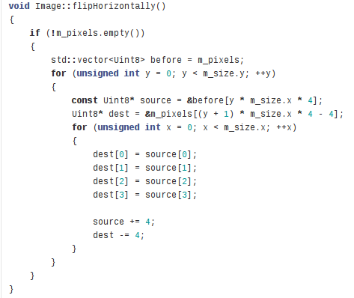
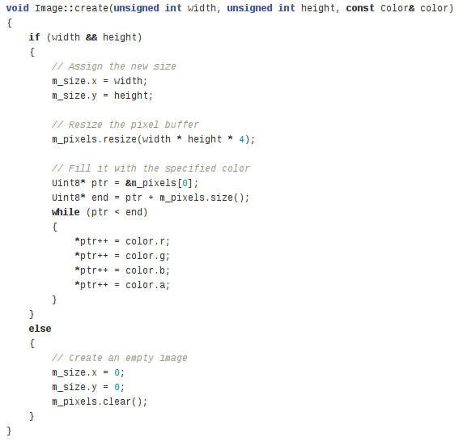
But SFML's Image inner-workings?
We don't need to know the inner workings of SFML's Image class in order to use it.
We simply need the documentation, which tells us the Image class's public functions.

Slide 38
But SFML's Image inner-workings?
SFML is an open source library for graphics, sound, networking, etc.
http://www.sfml-dev.org
https://github.com/LaurentGomila/SFML

Slide 39
Interface & Inner-workings
When we're using a third-party library, the interface we work with is what is public to us.
The inner workings are private, and aren't important for us to know to use the library.
Similarly, when we write classes in C++, we need to consider:
  What should be public – available to the user
  What should be private – what does the user not need to know?

Slide 40
Interface & Inner-workings
Abstraction
  Abstracting real-world problems or concepts into programming terms.
  e.g., turning “Payroll” information into an object
  e.g., turning a “Image” into an actual visible object on-screen.
Encapsulation
  “Encapsulating” data into an object
  Hiding inner-workings from users, and providing them with a clean interface to work with.
  “Black Box” development

Slide 41

Interface & Inner-workings
Encapsulation & Black box
  a black box is a device, system or object which can be viewed in terms of its input, output and transfer characteristics without any knowledge of its internal workings.
  http://en.wikipedia.org/wiki/Black_box
Output
Input
Data on monitor
On/off button
Data saved to floppy
Floppy-disk input
Computer explode
Keyboard-input
You can use a computer through its inputs, but do you know its inner-workings?

Slide 42
So, how do we do that?
Most class variable members should be private, so that only the class itself can access the stored data.
  For example, a “Bank Account” might have a “balance” variable.
  Have user access that through
    Deposit()
    Withdraw()
    PrintAccountBalance()
  Don't let user access balance directly:
    myAccount.balance += 100000;

Slide 43
So, how do we do that?
Have public functions that the user can access – these are part of the interface!
  Not every function needs to be public. There may be functions that help carry out the inner-workings functionality but the user doesn't need to mess with.
  yourAccount.FlagForIdentityFraud();

Slide 44
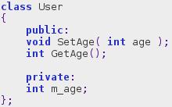
So, how do we do that?
If there are member variables the user needs access to, create Getter and Setter functions.
  Otherwise known as Accessors and Mutators.
Set m_age
Return m_age

Slide 45
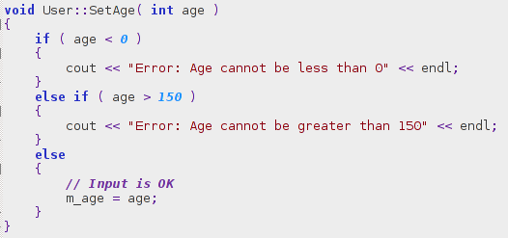
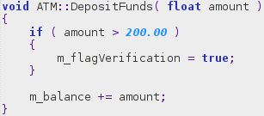
Why not make it easier and make members public, so directly accessible?
Yes, making members private and creating setters/getters is really important.
1. Validate input
If the user deposits more than $200, behind-the-scenes a flag is set to verify the amount.
If the user enters an invalid age, they get an error message and m_age is not updated.

Slide 46


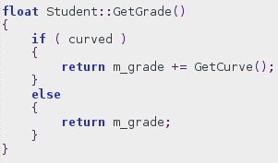
Why not make it easier and make members public, so directly accessible?
2. Format Output

Slide 47
Why not make it easier and make members public, so directly accessible?
3. Knowing the exact scope
  I was working on a project to update a feature at work. Old code, as per usual.
  A critical member variable was declared public instead of private.
  There was no good way to verify that changing this one variable wouldn't screw up a random other portion of the large code base. It was too risky, so we had to work around it. (And, therefore, create more confusing, nonsensical code)
  If the variable had been private, we could have ensured that only the public “getter” function was being used, and could make our changes “safely”.

Slide 48
Why not make it easier and make members public, so directly accessible?
If you're going to be programming professionally, or working on open source projects – or anything else someone might use – design is very important.
Good Object Oriented design helps us create software that is:
  Maintainable: Ability to fix bugs
  Reusable: Able to use not just in one product – in multiple products
  Updatable: Ability to add-on in the future
As a professional developer, you generally don't spend that much time “developing”.
  A lot of it is reading old code, figuring it out, and updating it.

Slide 49
Why not make it easier and make members public, so directly accessible?
Some types of software tend to be more “build-on and maintain” than “new development”.
  Business applications – they aren't going to just scrap what they have and start on something new.
  Web dev – Maybe the company builds websites for clients, that is more development than maintenance, but you might still be called in to maintain old sites.
    Some companies have in-house developers to work on their websites. Not all web dev is contract work for other companies.
  Game dev – Sometimes there's patching, but you generally don't get as many versions of a game as you do a software application. (ie, Photoshop v13 vs. Half-Life v13)
    Except MMORPGs, it seems.

Slide 50
Object Oriented Programming
There is a lot of information on Object Oriented Programming, including Criticism of, on the wikipedia page:
  https://en.wikipedia.org/wiki/Object-oriented_programming

